Slide 1
NETWORK ANALYSIS ARCHITECTURE AND DESIGN
*

Slide 2
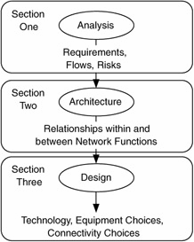
Network Design Phases
Designing a network is typically broken into three sections:
Determine requirements
Define the overall architecture
Choose technology and specific devices
(McCabe, 2003)
INFO 331
Network Design
*

Slide 3
Systems Methodology
There’s lots of room for refining these sections (Teare, 2004)
Identify customer requirements
Characterize the existing network
Design topology
Plan the implementation
Build a pilot network
Document the design
Implement the design, and monitor its use
INFO 331
Network Design
*

Slide 4
Two Main Principles
For a network design to work well, we need to balance between
Hierarchy – how much network traffic flows connect in tiers of organization
Like tiers on an org chart, hierarchy provides separation and structure for the network
Interconnectivity – offsets hierarchy by allowing connections between levels of the design, often to improve performance between them
INFO 331
Network Design
*

Slide 5
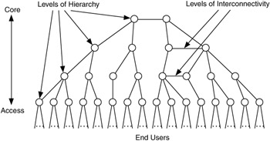
Two Main Principles
(McCabe, 2003)
INFO 331
Network Design
*

Slide 6
SERVICE REQUESTS AND REQUIREMENTS
They are identified by the degree of predictability needed from the service by the users, applications or devices
Best of effort
Predictable
Guarenteed
*

Slide 7
Best Of Effort Service
No control over how the network will satisfy the service requests
Indicates that the rest of the system will have to adapt to the state of the network at any given time
Services will be both un-predictable and unreliable
Variable performance across a range of values
No specific performance requirements
INFO 331
Network Design
*

Slide 8
GUARANTEED SERVICE
These services are predictable and reliable
They imply a contract between the user and the provider
When the contract is broken the provider is accountable and must account for loss of service and compensate the user.
INFO 331
Network Design
*

Slide 9
Predictable services
These services fall in between best of effort and guaranteed services
They offer some degree of predictability and yet are not accountable .
Predictable and guaranteed are based on some prior knowledge of and control over the state of the system
These services must have clear set of service requirements
These requirements must be configurable , measurable and verifiable
Ex: a bandwidth of 4-10 mbps. We should be able to communicate this request, measure / derive the level of resources needed and then determine whether the resources are actually available
INFO 331
Network Design
*

Slide 10
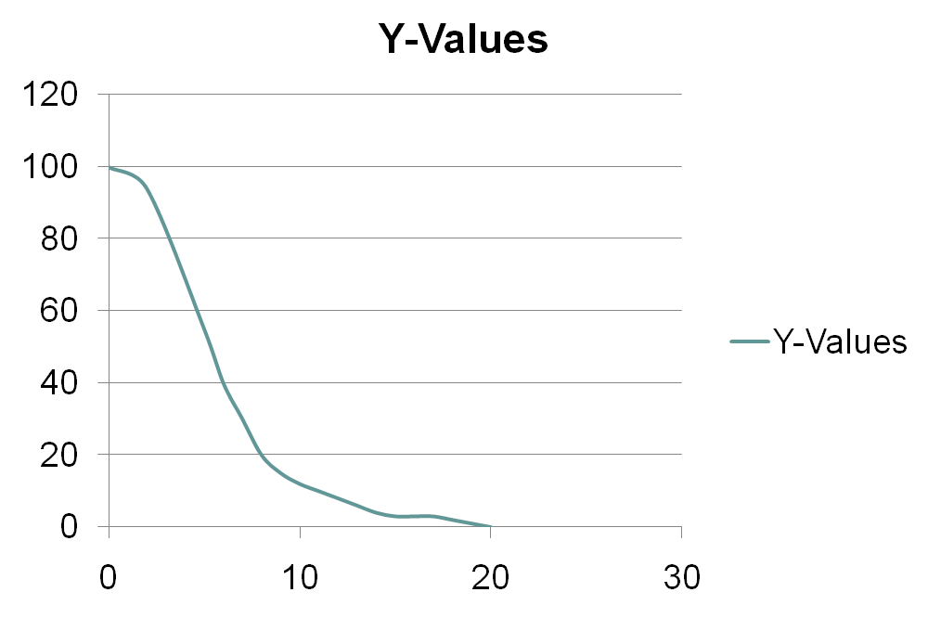
Ex: performance of a 100mbps FE connection.
INFO 331
Network Design
*

Slide 11
SERVICE METRICS
(i) Threshold values: is a value for a performance characteristic that is a boundary between two regions of conformance
(ii) limit: is a boundary between conforming and non conforming regions and is taken as an upper or lower limit for a performance characteristic.
Limits are more dangerous than thresholds and result in severe actions
INFO 331
Network Design
*

Slide 12
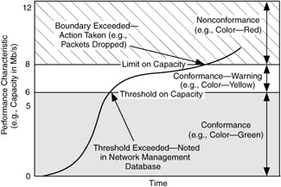
Requirements
Service requirements could include the QoS (quality of service) guarantees (ATM, Intserv, Diffserv, etc.)
This connects to network management monitoring of network performance
*

Slide 13
Performance Characteristics
Capacity
Delay
RMA
INFO 331
Network Design
*

Slide 14
Capacity
Is a measure of the systems ability to transfer information
Bandwidth, throughput and goodput are the terms associated with it.
INFO 331
Network Design
*

Slide 15
DELAY
Is the time difference in the transmission of information across the system.
Sources of delay (i) propagation delay (ii) transmission delay (iii) queuing and processing delay
Measures of delay( i) end-end delay (ii) RTT (iii) latency (iv) Delay Variation
INFO 331
Network Design
*

Slide 16
RMA Reliability
Is a statistical indicator of the frequency of failures of the network and its components
Reliability also requires some degree of predictability. The delivery of information must occur within well known time boundaries.
When delivery time varies greatly , the confidence in the network is lost and hence is considered less reliable
INFO 331
Network Design
*

Slide 17
Maintainability
Is a statistical measure of the time to restore the system to fully operational mode after it has experienced a fault
Generally expressed as
(i) MTTR (mean time to repair) : total time taken for detection, isolation of the failure to a component that can be replcaed, Delivery of necessary partsnto the location of the failed component (logistic time),replca the component, test it and restore full service
INFO 331
Network Design
*

Slide 18
Availability
Is a relationship between the frequency of mission critical failures and the time to restore service
A= MTBF/ (MTBF +MTTR)
MTBF = mean time between failures
MTTR = mean time to repair
A= availability
INFO 331
Network Design
*

Slide 19
Performance envelope
Is a combination of two or more performance requirements, with thresholds and upper and lower limits for each
INFO 331
Network Design
*

Slide 20
Network supportability
The 80/20 rule applies here
80% of the cost of a network is its operation and support
Only 20% is the cost of designing and implementing it
So plan for easy operation, maintenance, and upgrade of the network
INFO 331
Network Design
*

Slide 21
Post Implementation of the network life cycle
Phase 1: operation: The network and the systems are properly operated and managed and required maintenance are identified
Phase 2 : Maintenance: Preventive and corrective maintenance and the parts, tools plans and procedures for accomplishing this task
Phase 3: Human knowledge : Documentation, training and skilled person required to operate and maintain the system
INFO 331
Network Design
*

Slide 22
Key characteristics that Affect post implementation cost
Network and system Reliability
Network and system Maintainability
Training of the operators to stay within operational constraints
Quality of the staff required for maintenance actions
INFO 331
Network Design
*

Slide 23
Requirements? Booooring!
Yes, determining the requirements for a network probably isn’t as much fun as shopping for really expensive hardware
And that may be why many networks are poorly designed – no one bothered to think through their requirements!
Many people will jump to a specific technology or hardware solution, without fully considering other options – the obvious solution may not be the best one
INFO 331
Network Design
*

Slide 24
Requirements
We need to develop the low level design and the higher level architecture, and understand the environment in which they operate
We also need to prove that the design we’ve chosen is ‘just right’ (Southey, 1837)
Is that $2 million network backbone really enough to meet our needs?
How do we know $500,000 wouldn’t have been good enough?
INFO 331
Network Design
*

Slide 25
Requirements
Part of this process is managing the customer’s expectations
They may expect a much simpler or more expensive solution than is really needed
Showing analysis of different design options, technologies, or architectures can help prove you have the best solution
INFO 331
Network Design
*

Slide 26
Requirements
We need to use a systems approach for understanding the network
The system goes far beyond the network hardware, software, etc.
Also includes understanding the users, applications or services, and external environment
How do these need to interact?
What does the rest of the organization expect from the network?
INFO 331
Network Design
*

Slide 27
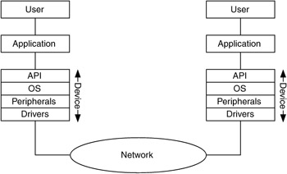
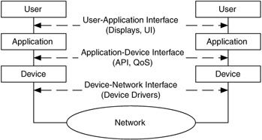
Requirements
Consider how devices communicate
Images from (McCabe, 2003) unless noted otherwise
INFO 331
Network Design
*

Slide 28
Requirements
What services are expected from the network?
Typical performance levels might include capacity, delay time, reliability
Providing 1.5 Mb/s peak capacity to a remote user
Guaranteeing a maximum round-trip delay of 100 ms to servers in a server farm
Functions include security, accounting, scheduling, management
Defining a security or privacy level for a group of users or an organization
INFO 331
Network Design
*

Slide 29
Requirements
Capacity refers to the ability to transfer data
Bandwidth is the theoretical capacity of some part of the network
Throughput is the actual capacity, which is less than the bandwidth, due to protocol overhead, network delays, etc.
Kind of like hard drive actual capacity is always less than advertised, due to formatting
INFO 331
Network Design
*

Slide 30
Requirements Analysis
Given these concepts, how do we describe requirements for a network?
Need a process to filter or classify requirements
Network requirements (often have high, medium, low priorities)
Future requirements (planned upgrades)
Rejected requirements (remember for future ref.)
Informational requirements (ideas, not required)
INFO 331
Network Design
*

Slide 31
Requirements Analysis
Requirements can come from many aspects of the network system
User Requirements
Application Requirements
Device Requirements
Network Requirements
Other Requirements
INFO 331
Network Design
*

Slide 32
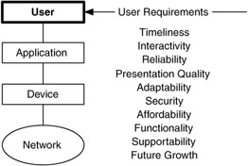
User Requirements
User requirements are often qualitative and very high level
What is ‘fast enough’ for download? System response (RTT)?
How good does video need to be?
What’s my budget?
INFO 331
Network Design
*

Slide 33
Application Requirements
What types of apps are we using?
Mission-critical
Rate-critical
Real-time and/or interactive
How sensitive are apps to RMA (reliability, maintainability, availability)?
What capacity is needed?
What delay time is acceptable?
INFO 331
Network Design
*

Slide 34
Application Requirements
What groups of apps are being used?
Telemetry/command and control - remote devices
Visualization and simulation
Distributed computing
Web development, access, and use
Bulk data transport – FTP
Teleservice – VOIP, teleconference
Operations, admin, maintenance, and provisioning (OAM&P) – DNS, SMTP, SNMP
Client-server – ERP, SCM, CRM
INFO 331
Network Design
*

Slide 35
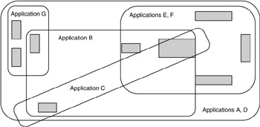
Application Requirements
Where are the apps located?
Are some only used in certain locations?
INFO 331
Network Design
*

Slide 36
Device Requirements
What kinds of devices are on your network?
Generic computing devices include normal PCs, Macs, laptops, handheld computers, workstations
Servers include all flavors of server – file, print, app/computation, and backup
Specialized devices include extreme servers (supercomputers, massively parallel servers), data collection systems (POS terminals), industry-specific devices, networked devices (cameras, tools), stoplights, ATMs, etc.
INFO 331
Network Design
*

Slide 37
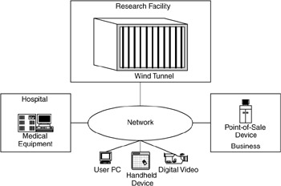
Device Requirements
Specialized devices are often location-specific
INFO 331
Network Design
*

Slide 38
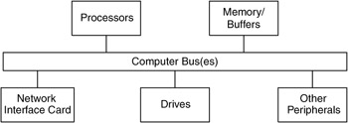
Device Requirements
We want an understanding of the device’s performance – its ability to process data from the network
Device I/O rates
Delay time for performing a given app function
INFO 331
Network Design
*

Slide 39
Device Requirements
Performance results from many factors
Storage performance, that is, flash, disk drive, or tape performance
Processor (CPU) performance
Memory performance (access times)
Bus performance (bus capacity and arbitration efficiency)
OS performance (effectiveness of the protocol stack and APIs)
Device driver performance
INFO 331
Network Design
*

Slide 40
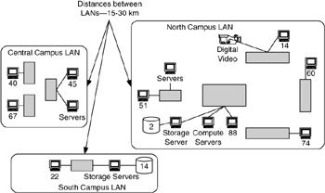
Device Requirements
The device locations are also critical
Often generic devices can be grouped by their quantity
Servers and specialized stuff are shown individually
INFO 331
Network Design
*

Slide 41
Network Requirements
Network requirements (sounds kinda redundant) are the requirements for interacting with the existing network(s) and network management concerns
Most networks have to integrate into an existing network, and plan for the future evolution of the network
INFO 331
Network Design
*

Slide 42
Network Requirements
Issues with network integration include
Scaling dependencies – how will the size of the existing network affect the new one?
Will the existing network change structure, or just add on a new wing?
Location dependencies – interaction between old and new networks could change the location of key components
Performance constraints – existing network could limit performance of the new one
INFO 331
Network Design
*

Slide 43
Network Requirements
Network, system, and support service dependencies
Addressing, security, routing protocols and network management can all be affected by the existing network
Interoperability dependencies
Changes in technology or media at the interfaces between networks need to be accounted for, as well as QoS guarantees, if any
Network obsolescence – do protocols or technologies become obsolete during transition?
INFO 331
Network Design
*

Slide 44
Network Requirements
Network management and security issues need to be addressed throughout development
How will the network be monitored for events?
Monitoring for network performance?
What is the hierarchy for management data flow?
Network configuration?
Troubleshoot support?
INFO 331
Network Design
*

Slide 45
Network Requirements
Security analysis can include the severity (effect) of an attack, and its probability of occurrence
Effect/ Probability | User Devices | Servers | Network | Software | Services | Data
Unauthorized Access | B/A | B/B | C/B | A/B | B/C | A/B
Unauthorized Disclosure | B/C | B/B | C/C | A/B | B/C | A/B
Denial of Service | B/B | B/B | B/B | B/B | B/B | D/D
Theft | A/D | B/D | B/D | A/B | C/C | A/B
Corruption | A/C | B/C | C/C | A/B | D/D | A/B
Viruses | B/B | B/B | B/B | B/B | B/C | D/D
Physical Damage | A/D | B/C | C/C | D/D | D/D | D/D
Effect: |  |  | Probability:
A: Destructive |  | C: Disruptive |  | A: Certain | C: Likely
B: Disabling |  | D: No Impact |  | B: Unlikely | D: Impossible
INFO 331
Network Design
*

Slide 46
Other Requirements
Requirements can come from other outside sources – your customer, legal requirements, larger scale organization (enterprise) requirements, etc.
Additional requirements can include
Operational suitability – how well can the customer configure and monitor the system?
Supportability – how well can the customer maintain the system?
INFO 331
Network Design
*

Slide 47
Other Requirements
Confidence – what is the data loss rate when the system is running at its required throughput?
Financial requirements can include not only the initial system cost, but also ongoing maintenance costs
System architecture may be altered to remain within cost constraints
This is a good reason to present the customer with design choices, so they see the impact of cost versus performance
INFO 331
Network Design
*

Slide 48
Other Requirements
Enterprise requirements typically include integration of your network with existing standards for voice, data, or other protocols
INFO 331
Network Design
*

Slide 49
Requirements Spec and Map
A requirements specification is a document which summarizes the requirements for (here) a network
Often it becomes a contractual obligation, so assumptions, estimates, etc. should be carefully spelled out
Requirements are classified by Status, as noted earlier (core/current, future, rejected, or informational requirement)
INFO 331
Network Design
*

Slide 50
Requirements of an Company
1building must .150 users (60 engineers, 15 HR, and finance, 30 manufacturing 10 management, 30 sales/marketing, 5 others)
Each area in building the support fast ethernet connection to the backbone
Database ,visualisation Manufacturing, and payroll applications are considered mission critical
Inventory applications are not determined at this time
Database applications require a min. of 150kbps
Engineering users have a workstation with gigaE NICs
Visualisation applications for finance require 40Mbps capacity and 100ms round trip delay
Payroll apps require 100% up time
Company must be secure from internet attack
Company requires a min. of T! access to internet
INFO 331
Network Design
*

Slide 51
Requirements Spec and Map
Priority can provide additional numeric distinction within a given Status (typically on a 1-3 or 1-5 scale)
Sources for Gathering requirements can be identified, or give basis for Deriving it
Type is user, app, device, network or other
Requirements Specification
ID/Name | Date | Type | Description | Gathered/Derived | Locations | Status | Priority
INFO 331
Network Design
*

Slide 52
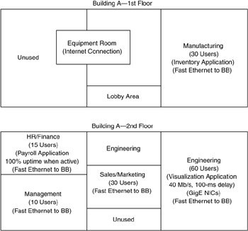
Requirements Spec and Map
Requirements Mapping can show graphically where stuff is, what kind of apps are used, and existing connectivity
INFO 331
Network Design
*

